Slide 1
Copyright warning
Sharing, copying, reproduction or distribution of this presentation in any form or by any means is strictly prohibited.
Permission to use this PowerPoint presentation is granted only to schools which have purchased the InitiaLit–1 program in its entirety and which have completed the associated training with MultiLit Pty Ltd. All other conditions of sale must also be complied with.

Slide 2
InitiaLit
Lesson 21: Introduction to nouns

Slide 3
Activity 1: Review

Slide 4
Activity 1: Review
Step 1

Slide 5
Activity 1: Review
Step 2

Slide 6
Activity 1: Review
Step 3

Slide 7
Activity 1: Review
Step 4

Slide 8
Activity 1: Review
Step 5

Slide 9
Activity 1: Review
Steps 6 – 7

Slide 10
Activity 1: Review
Step 8

Slide 11
Activity 2: Reading and spelling tricky words – saw, friend, school

Slide 12
Activity 2: Reading and spelling tricky words – saw, friend,
school
Steps 1 – 8

Slide 13
Activity 2: Reading and spelling tricky words – saw, friend,
school
Step 9

Slide 15
Activity 2: Reading and spelling tricky words – saw, friend,
school
Final review for reading – Set 3 and 4 (‘saw’, ‘school’, ‘friend’ only)
Step 10

Slide 26
Activity 2: Reading and spelling tricky words – saw, friend,
school
Step 11
Refer to Handbook

Slide 27
Activity 3: Introduction to nouns

Slide 28
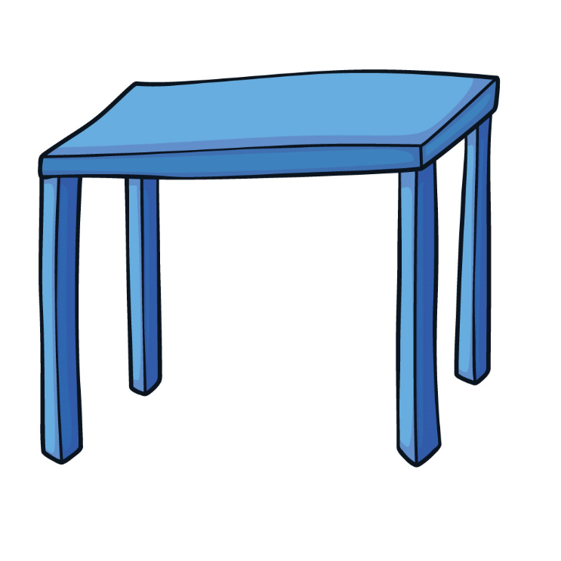
Activity 3: Introduction to nouns
Steps 1 – 3

Slide 29
Activity 3: Introduction to nouns
Steps 4 – 5

Slide 30
Activity 3: Introduction to nouns
Step 6

Slide 31
Activity 3: Introduction to nouns
Step 7

Slide 32
Activity 3: Introduction to nouns
Steps 8 – 12
Refer to Handbook

Slide 33
Activity 3: Introduction to nouns
Concept Card
Step 13

Slide 34
Activity 3: Introduction to nouns
Concept Card
Step 14

Slide 35
Activity 3: Introduction to nouns
Step 15
Refer to Handbook

Slide 36
Activity 4: Noun song

Slide 37
Activity 4: Noun song
Step 1

Slide 38
Activity 4: Noun song
Steps 2 – 4

