Slide 1
Copyright warning
Sharing, copying, reproduction or distribution of this presentation in any form or by any means is strictly prohibited.
Permission to use this PowerPoint presentation is granted only to schools which have purchased the InitiaLit–1 program in its entirety and which have completed the associated training with MultiLit Pty Ltd. All other conditions of sale must also be complied with.

Slide 2
InitiaLit
Lesson 19: Compound words

Slide 3
Activity 1: Review

Slide 4
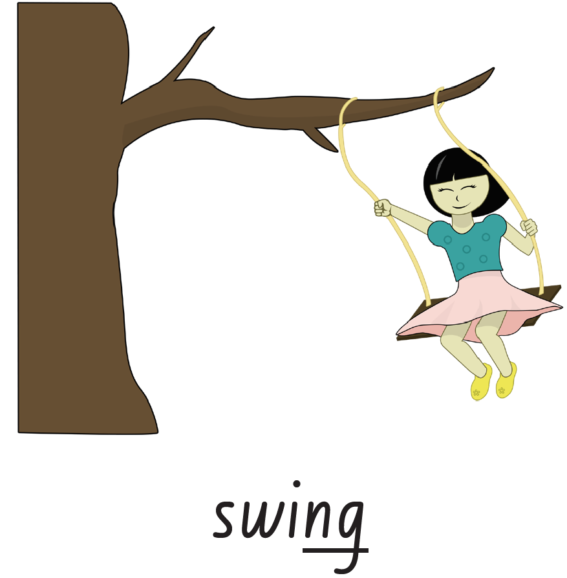
Activity 1: Review
Letter-sound correspondence
Step 1

Slide 5
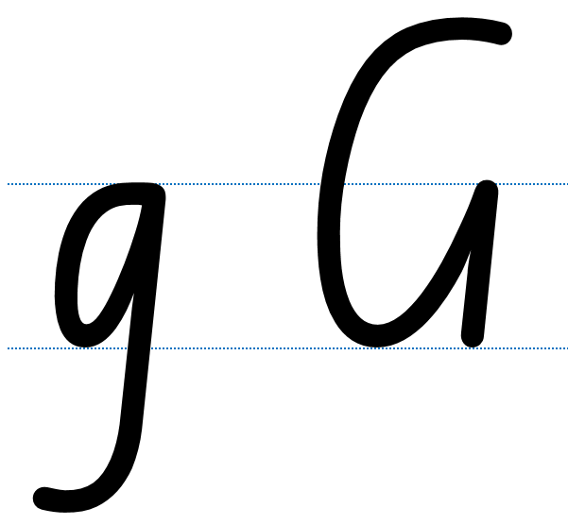
Activity 1: Review
Letter-sound correspondence
Step 2

Slide 8
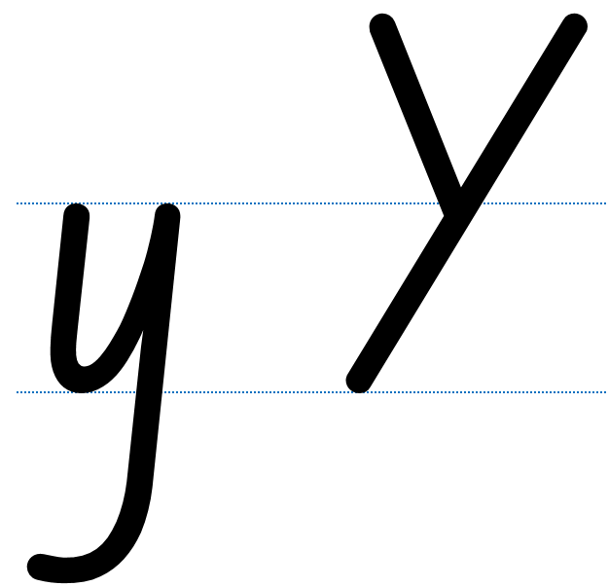

Slide 16
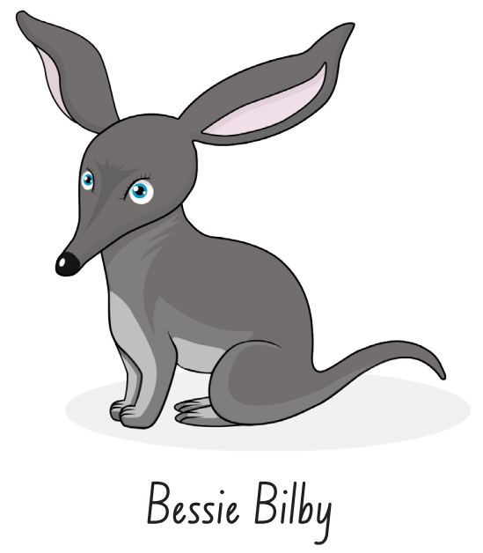

Slide 17
Activity 1: Review
Tricky words for spelling
Steps 3 – 4

Slide 18
Activity 1: Review
Tricky words for spelling
Step 5

Slide 19
Activity 1: Review
Tricky words for spelling
Step 6

Slide 20
Activity 1: Review
Tricky words for spelling
Steps 8 − 9

Slide 21
Activity 2: Introduction to compound words

Slide 22
Activity 2: Introduction to compound words
Steps 1 – 2

Slide 23
Activity 2: Introduction to compound words
Steps 3 – 4

Slide 24
Activity 2: Introduction to compound words
Step 5

Slide 29
Activity 2: Introduction to compound words
Steps 6 – 7
Refer to Handbook

Slide 30
Activity 2: Introduction to compound words
Concept card
Step 8

Slide 31
Activity 2: Introduction to compound words
Concept card
Step 9

Slide 32
Activity 2: Introduction to compound words
Steps 10 – 11
Refer to Handbook

Slide 33
Activity 3: Compound words for reading

Slide 34
Activity 3: Compound words for reading
Demonstration
Step 1
Refer to Handbook

Slide 35
Activity 3: Compound words for reading
Demonstration
Step 2

Slide 36
Activity 3: Compound words for reading
Steps 3 – 4

Slide 37
Activity 3: Compound words for reading
Steps 5 – 8

Slide 38
Activity 3: Compound words for reading
Step 9

Slide 45
Activity 4: Find-a-Partner

Slide 46
Activity 4: Find-a-partner
Steps 1 – 6
Refer to Handbook

