Slide 1
Copyright warning
Sharing, copying, reproduction or distribution of this presentation in any form or by any means is strictly prohibited.
Permission to use this PowerPoint presentation is granted only to schools which have purchased the InitiaLit–1 program in its entirety and which have completed the associated training with MultiLit Pty Ltd. All other conditions of sale must also be complied with.

Slide 2
InitiaLit
Lesson 20: Compound words

Slide 3
Activity 1: Review

Slide 4
Activity 1: Review
Oral blending and segmenting: Toss and Catch
Steps 1 – 6
Refer to Handbook

Slide 5
Activity 1: Review
Tricky word spelling – some, where, should
Steps 7 – 8

Slide 6
Activity 1: Review
Tricky word spelling – some, where, should
Step 9

Slide 7
Activity 1: Review
Tricky word spelling
Steps 10 − 11

Slide 8
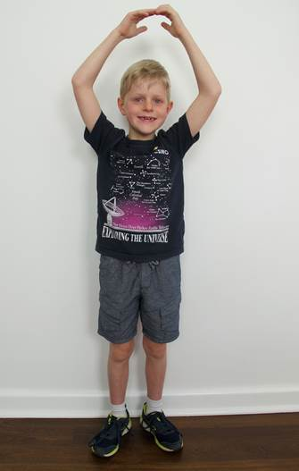
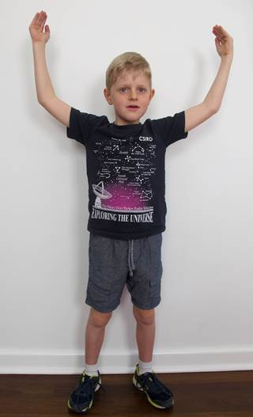
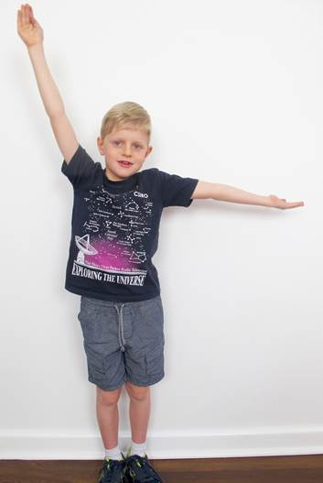
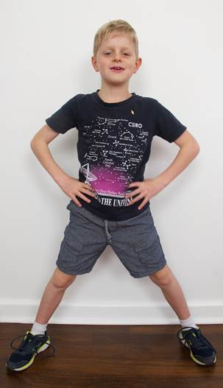
Activity 1: Review
Tricky word spelling
Steps 12 − 13

Slide 9
Activity 2: Compound words – reading words and sentences

Slide 10
Activity 2: Compound words – reading words and sentences
Steps 1 – 3

Slide 11
Activity 2: Compound words – reading words and sentences
Steps 4 – 7

Slide 12
Activity 2: Compound words – reading words and sentences
Step 8

Slide 17
Activity 2: Compound words – reading words and sentences
Steps 9 – 12

Slide 20
Activity 3: Compound Word Pairs

Slide 21
Activity 3: Compound Word Pairs
Compound Word Pairs
Steps 1 – 4
Refer to Handbook

Slide 22
Move to desks to complete Activity 4: Compound words – spelling

Slide 23
Activity 4: Compound words – spelling

Slide 24
Activity 4: Compound words – spelling
Steps 1 – 7
Refer to Handbook

